Slide 1

ATAL INDORE CITY TRANSPORT

Slide 2
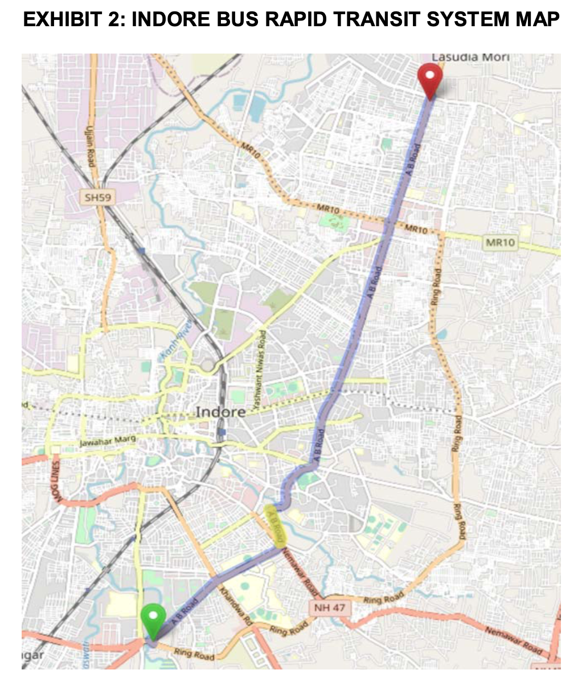
Content
Overview
Assumptions
Methodology
Results
Recommendations
Limitations

Slide 3
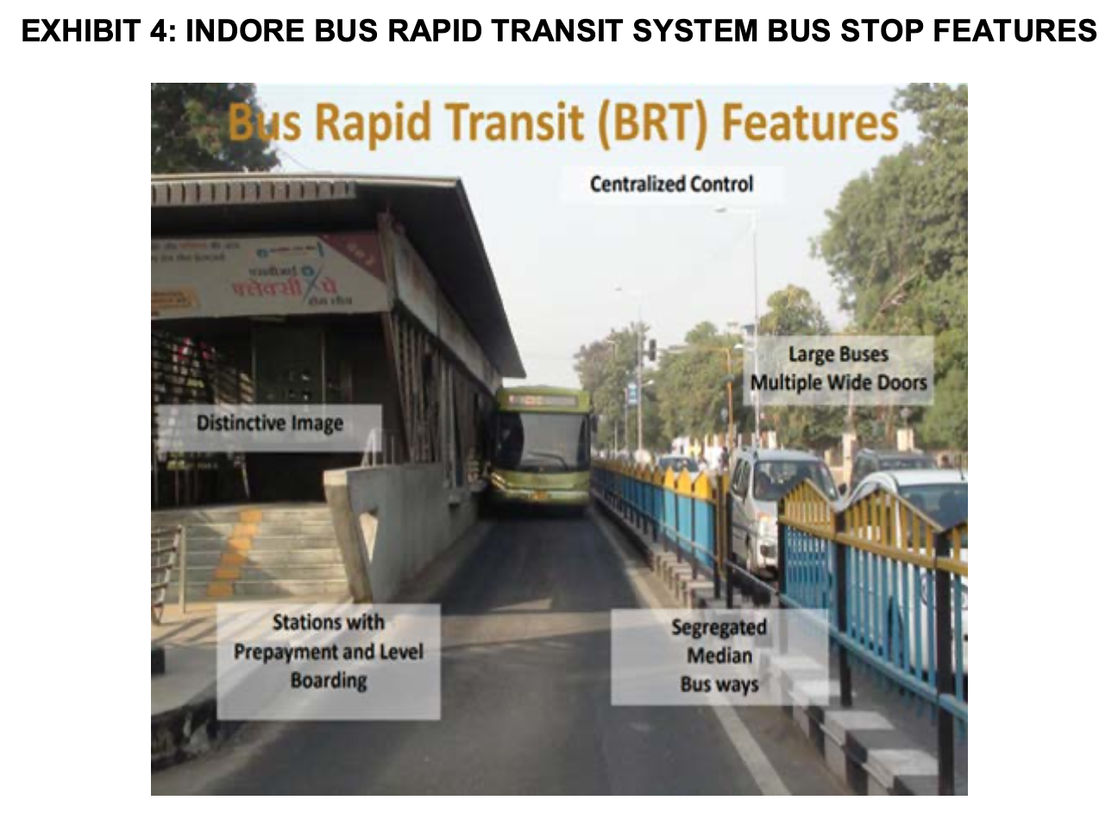
Overview
Indore is a city in the state of Madhya Pradesh, India
The immense traffic problems in the city, along with poor road infrastructure and public transport needed to be dealt with.
The Atal Indore City Transport Service Ltd. (AICTSL) created a BRTS model in 2007.
Bus-Rapid Transit was initiated on specific routes to encourage the public to use public transportation, thus reducing their reliance on private vehicles.

Slide 4
Assumptions
Assumption 1
Assumption 2
Assumption 3
We are calculating the number of buses needed on the route for peak and non-peak timings
There will be no other causality affecting the operation of the bus on these route.
No more than 51 people can be in the bus at any given time.

Slide 5
Methodology
Generating
Passenger Demands
Calculating Passenger Number
Optimizing Bus Number
Optimizing Headway Time
Notes:
Firstly, we applied Monte Carlo simulation to facilitate the modeling of Indore BRTS passenger demand and the optimization of headway which considers both the fulfillment of customer satisfaction and the reduction of operational costs. Then we divided the Indore BRTS passenger demand into four parts: demand during peak hours from Rajiv Gandhi to Niranjanpur Square, demand during peak hours from Niranjanpur Square to Rajiv Gandhi, demand during non-peak hours from Rajiv Gandhi to Niranjanpur Square, and demand during non-peak hours from Niranjanpur Square to Rajiv Gandhi. We calculated the hourly demand by dividing the demand value by the duration (four hours for peak hours and three hours for non-peak hours).
For each of the above routes, we created 1000 trials; in each, we randomly generated a whole set of passenger demands by assuming a normal distribution with the mean equal to the observed value and the standard deviation equal to 20% of the observed value. Then, for each trial, we calculated the number of people getting on to the bus at each station, the number of people getting off the bus at each station, and the number of people on the bus when the bus leaves a station.
We then optimized the headway value for each trial to ensure that the headway value could approximate the threshold of passenger demand (which is inferred from the maximum value of the number of people on the bus through the route) but not exceed it, meaning that we aim at fulfilling all the demand but not wasting any resources more than required. Since the relationship between service quality and costs is always linear – the better the service quality, the higher the costs – we could easily deduce that a lower headway value, which means a shorter time the passenger needs to wait, results in both higher customer satisfaction and higher costs, and vice versa.

Slide 6
Results
The optimal number of buses
Backup Strategy
Recommendations
Limitations & Constraints

Slide 7
The optimal number of buses
18 buses
Rajiv Gandhi
Niranjanpur Square
21 buses
Peak Hour Condition
5 buses
Rajiv Gandhi
Niranjanpur Square
5 buses
Non-Peak Hour Condition
Notes:
For the route from Rajiv Gandhi to Niranjanpur Square during peak hours, The optimal number of buses required is 18. For the route from Niranjanpur Square to Rajiv Gandhi during peak hours, The optimal number of buses required is 21.
For the route from Rajiv Gandhi to Niranjanpur Square during non-peak hours, The optimal number of buses required is 5. For the route from Niranjanpur Square to Rajiv Gandhi during non-peak hours, The optimal number of buses required is 5.

Slide 8
Back-up Strategy
18 buses
Rajiv Gandhi
4 buses back up
Niranjanpur Square
21 buses
Peak Hour Condition
5 buses
Rajiv Gandhi
1 bus back up
Niranjanpur Square
5 buses
Non-Peak Hour Condition
Notes:
Holding the awareness of the potential existence of accidents, breakdowns, and weather issues during the operation hours of Indore BRTS, our group recommends that AICTSL should also prepare backup vehicles and drivers to support the normal operation of the system even when dealing with special circumstances. Our group thinks that preparing 10% of the number of buses on the route would be a sufficient backup plan for the Indore BRTS. During the peak hours, this value should be 10% * (18+21) = 3.9; during the non-peak hours, this value should be 10% * (5+5) = 1. Hence, our group would like to suggest that preparing 4 buses during peak hours and 1 bus during non-peak hours should be the backup strategy for AICTSL.

Slide 9
Recommendations
Rajiv Gandhi to Niranjanpur Square
(Peak Hours)
headway time - 2.43 minutes
buses operate - 18
back-up. - 4 (peak hours)
headway time - 7.32 minutes
buses operate - 5
back-up. - 1 (non-peak hours)
Rajiv Gandhi to Niranjanpur Square
(Non-Peak Hours)
headway time - 2.19
buses operate - 21
back-up. - 4 (peak hours)
Niranjanpur Square to Rajiv Gandhi
(Peak Hours)
Niranjanpur Square to Rajiv Gandhi
(Non-Peak Hours)
headway time - 6.83 minutes
buses operate - 5
back-up. - 5 (non-peak hours)

Slide 10
Limitations & Constraints
Overly idealistic assumptions
No monetary quantification
Too few trials
Notes:
Despite the results we obtained, this study still has many limitations that we should learn for future improvements. First, in this study, we created 1000 trials in total to simulate the passenger demand for each route due to constraints brought by the long simulation processing time of R Studio. In such a study, a larger number of trials will always be preferable because it can offer a more accurate and “baked-in” prediction of what will happen to assist us in turning in a more reliable result. Second, in the simulation and calculation, our group assumed a smooth and homogenous process in the BRTS routes without taking the time to let the passengers get on the bus and the uneven distribution of bus speed throughout the route in practice. Third, in this study, we failed to monetarize and quantify the gain and loss of customer satisfaction to choose a more financially reasonable balance point between customer satisfaction and operational costs. We decided to fulfill passenger demand for 90% of the time directly, yet a better choice could be made if we could model the customer satisfaction in monetary value.

Slide 11
Thank you!

